Slide 1
OPERATIONAL –AMPLIFIERS (A Short Study)
The LNM IIT, Jaipur

Slide 2
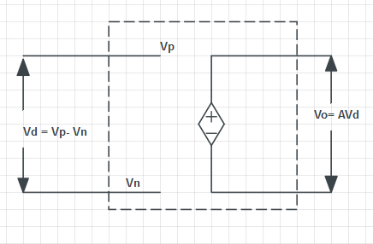
OP-AMP
It is made up of 24 transistors and RC networks.
Also called High Voltage Gain Amplifier.
8 Pin Package.
It amplifies the input voltage difference.

Slide 3
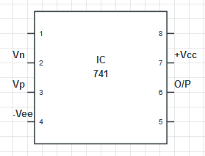
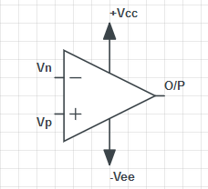
V_{D} = V_{P} - V_{N}
V_{P} - Non- inverting Input
V_{N} - inverting Input
V_{D} - Differential Input
V_{O} = A_{i} V_{D}
a - High gain/Open loop gain of the Op-Amp, 10⁵< a < 10⁷
Output cannot exceed the biasing voltages.

Slide 4
Properties of Op- Amp :-
High Input Impedance (Take Max. Input)
Low Output Impedance (Provide Max. Output)
High Voltage Gain (a)
Large Bandwidth
Perfect balance. (If V_{D} =0 then V_{O} =0)
Independent of temperature.

Slide 5
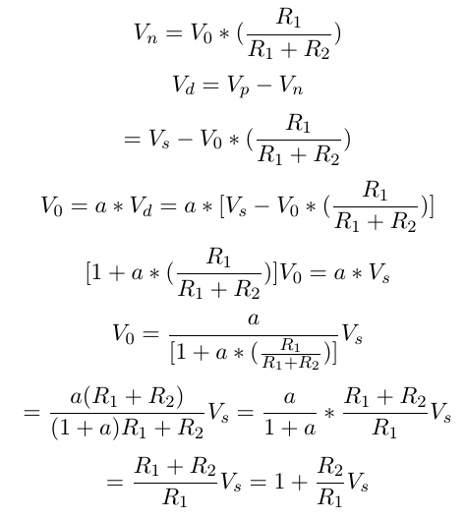
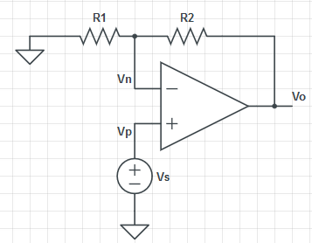
Basic Configuration:-
A) Non Inverting Amplifier:-

Slide 6
Gain A = 1 + (R2 / R1) is known as closed loop gain.
If R2 = 0 ; A=1 i.e. V0 = Vs ; The circuit is known as Voltage follower.
But High input impedance and Low output impedance make sure that there is NO loading effect like BJT emitter follower.

Slide 7
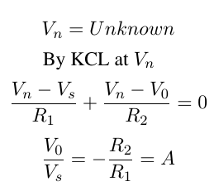
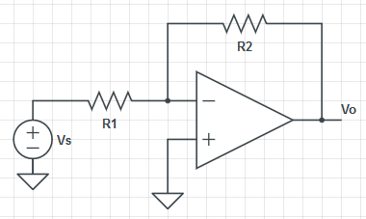
B) Inverting Amplifier:-
It Provides 180⁰ phase shift at output due to negative sign present.

Slide 8
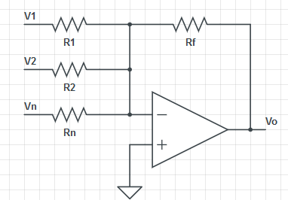


C) Summing Amplifier:-
;When all resistors are equal
Output voltage is sum of all inputs but with a negative value times the gain (R_{f} /R) of amplifier.
If R_{f} =R, Then gain of circuit is unity.
Output voltage is equal to the negative sum of all input voltages

Slide 9
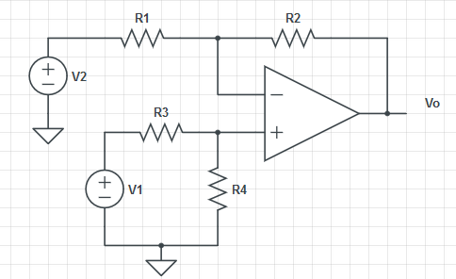
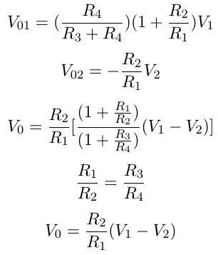
D) Difference Amplifier:-
By linearity, firstly we find V01 and V02
If we consider

Slide 10
A difference amplifier is a type of electronic amplifier that amplifies the difference between two input voltages but suppresses any voltage common to the two inputs.
If all the resistors are all of the same ohmic value, that is: R1 = R2 = R3 = R4 then the circuit will become a Unity Gain Differential Amplifier
Voltage gain of the amplifier will be exactly one or unity

Slide 11
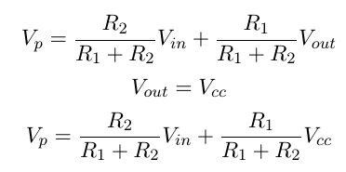
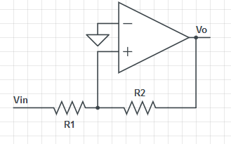



E) Schmitt Trigger:-
Let
When Vp = 0, Comparator will switch
Vin must drop below to get Output to switch
Now Vout = -Vcc
So Next Threshold will be

Slide 12
A Schmitt trigger is an electronic circuit that is used to detect whether a voltage has crossed over a given reference level.
A Schmitt trigger circuit is a fast-operating voltage-level detector.
When the input voltage arrives at the upper or lower trigger levels, the output changes rapidly.

Slide 13
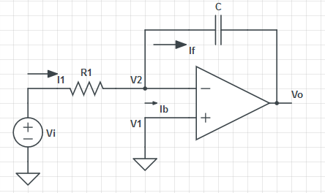
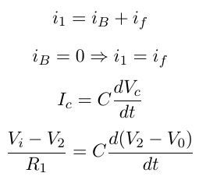
F) OP-AMP Integrator :-
But
For Capacitor
V2 = V1 =0 ;for ideal Op-amp

Slide 14
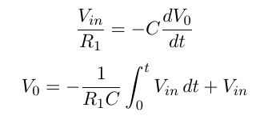
Where Vin is the output voltage at t=0
The Integrator Amplifier is an operational amplifier circuit that performs the mathematical operation of Integration, that is we can cause the output to respond to changes in the input voltage over time and the integrator amplifier produces a voltage output which is proportional to that of its input voltage with respect to time.

Slide 15
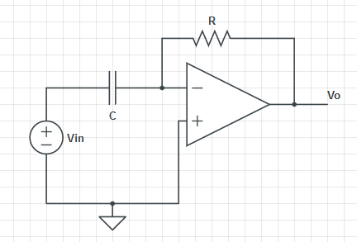

G) OP-AMP Differentiator :-
A circuit that performs the mathematical differentiation of the input signal is called a “differentiator”. i.e. the output of the differentiator is proportional to the rate of change of its input signal. By introducing electrical reactance (resistance or capacitance) into the feedback loops of op-amp amplifier circuits, we can cause the output to respond to changes in the input voltage with time.

Slide 16
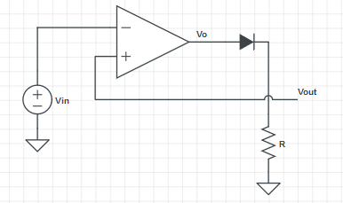
H) Precision Rectifier :-
When Vin < 0;
Vout = -Vcc => Vout=0
When Vin > 0;
Vout = Vcc ; Voltage Follower
Hence for case ii, Output follows Input.
It is a configuration obtained with an operational amplifier in order to have a circuit behaving like an ideal and rectifier.

Slide 17
When the input voltage is negative, there is a negative voltage on the diode, too, so it works like an open circuit, there is no current in the load and the output voltage is zero.
When the input is positive, it is amplified by the operational amplifier and it turns the diode on.
There is current in the load and, because of the feedback, the output voltage is equal to the input.

Slide 18




Examples :
1) For a non - inverting amplifier, if R₁ = 10KΩ , R₂ = 20KΩ , open loop gain= 10⁶ , Find closed loop gain.
Sol:- = 2.999991
= 3
2) For a summing amplifier with R_{F} = 15KΩ, and three input V_{1,}V₂ and V₃ . If V_{o} = -2V₁ -3V₂ -5V₃ . Find R₁ , R₂ and R₃ .
Sol:-
So

Slide 19



Design a summing amplifier, that accepts two sources whose internal resistances are 10KΩ , 4KΩ and V_{o} = -10V₁ -18V₂ .
Design a circuit with V_{o} = 4V₁ -2V₂ . Both V₁ and V₂ have internal resistance = 1KΩ.
Sol:-

Slide 20
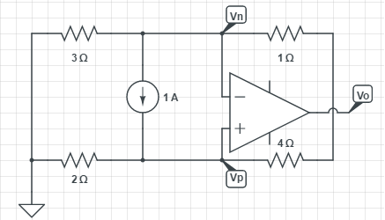
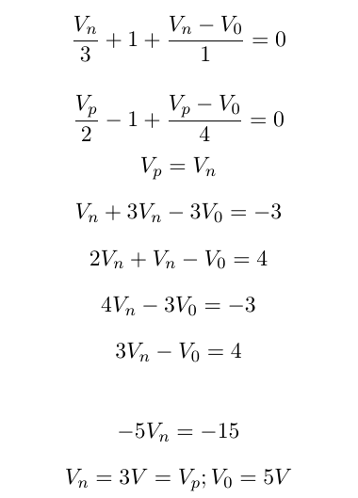

Op-Amp Circuit Analysis
1) Problem :
KCL @ Vn :
KCL @ Vp :
_{o}
Virtual Ground :

Slide 21
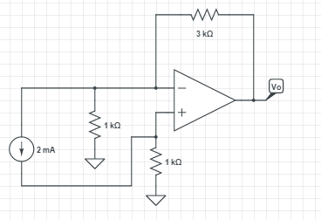
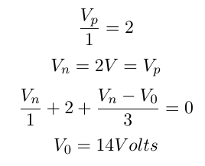
2) Question :
KCL @ Vp :
KCL @ Vn :

Slide 22
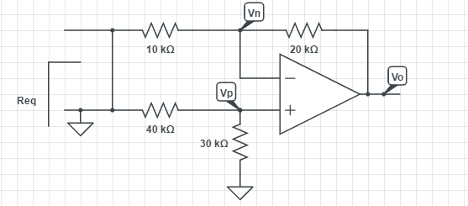
3) Question :
To find Req, we apply Vtest and find Itest. Then Req can be found.

Slide 23
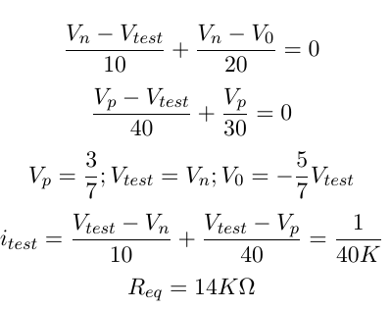
Sol –
KCL @ Vn :
KCL @ Vp :
KCL @ Vtest :

Slide 24
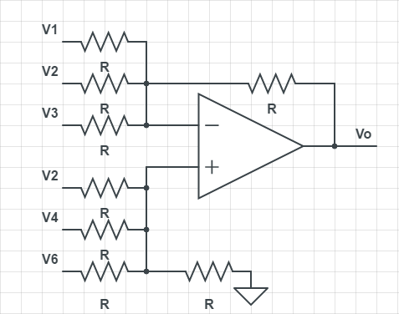
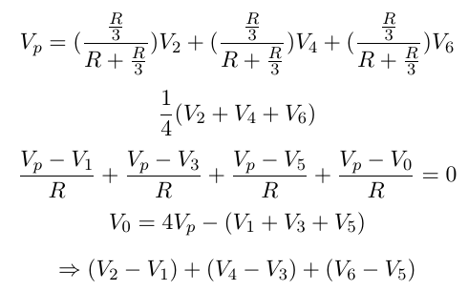
4) Question : Find V0 ?

Slide 25
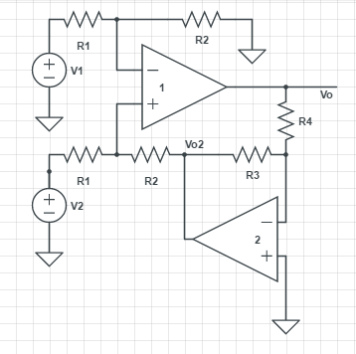
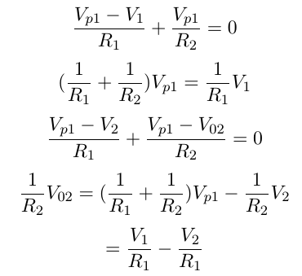
4) Question : Find V0 , V02 ?
We assume Vn1 = Vp1 &
Vn2 = Vp2
KCL @ Vp1 :
KCL @ Vn1 :

Slide 26
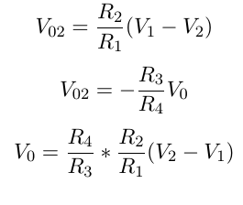
Also,

Slide 27
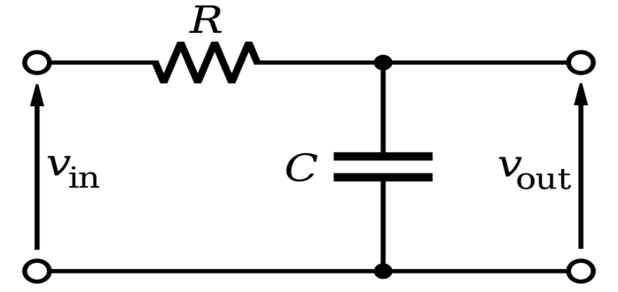

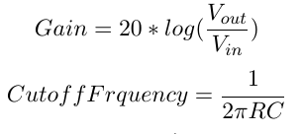

FILTERS
Passive Filters
1) Low Pass Filter
Capacitive Reactance
Since Xc/z keep on decreasing with increasing in frequency.
Higher frequency input provides low output.
For higher order Filter

Slide 28
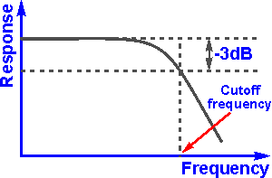
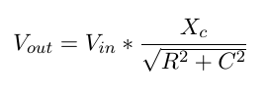
Frequency Response For Low Pass Filter

Slide 29
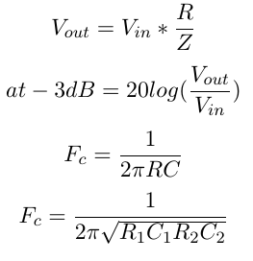
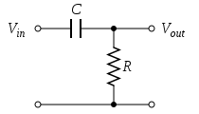
2) High Pass Filter
For 2nd order :
Since R/Z is low for lower frequencies and high for higher frequencies
Therefore , higher output at higher frequencies

Slide 30
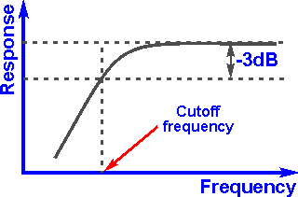
Frequency Response For High Pass Filter

Slide 31
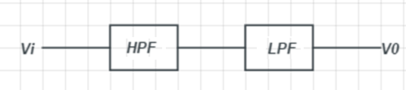
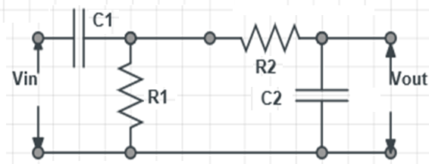
3) Band Pass Filter

Slide 32
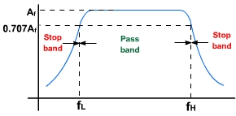

Frequency Response For Band Pass Filter

Slide 33
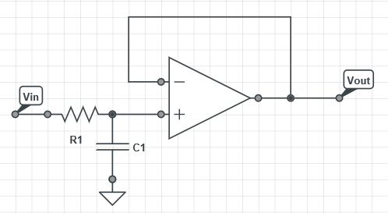
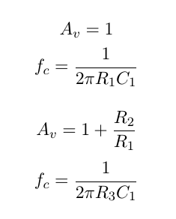
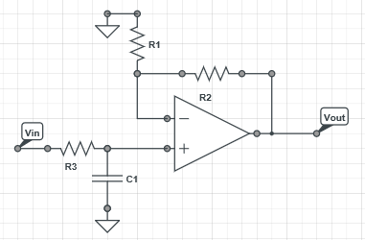
Active Filters
1) Low Pass Filter :-
With Gain :

Slide 34
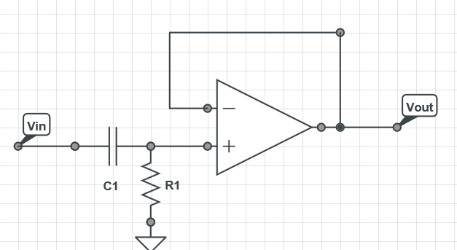
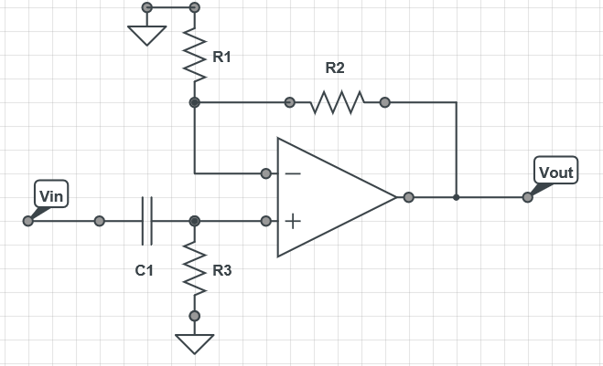
2) High Pass Filter :-
With Gain :

Slide 35
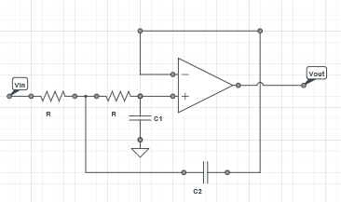
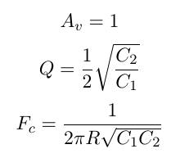
Second Order Filters

Slide 36
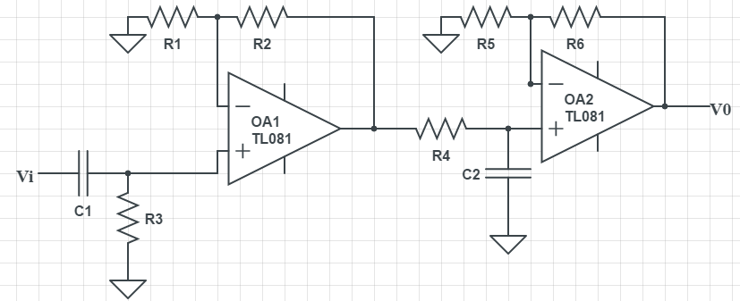
Active Band Pass Filter

Slide 37
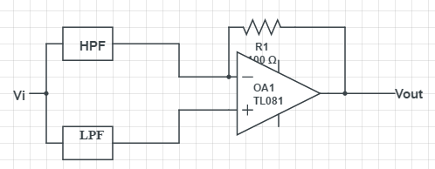
Band Stop Filter

